Slide 1

By Vishwa Teja Vangari

Slide 2

Agenda:
KSQL
Benefits
KSQL Syntaxes & Semantics
KSQL Examples
DEMO

Slide 3
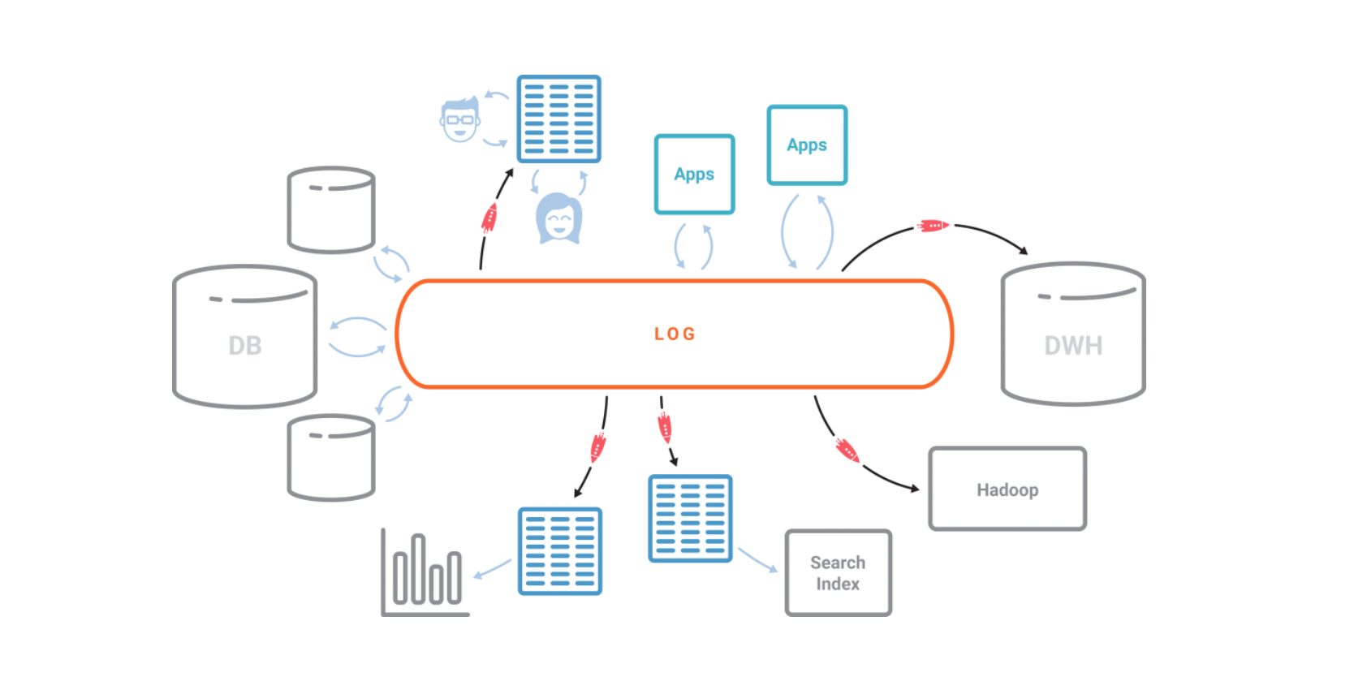
Recap of Apache KAFKAOG

Slide 4


Slide 5


Slide 6
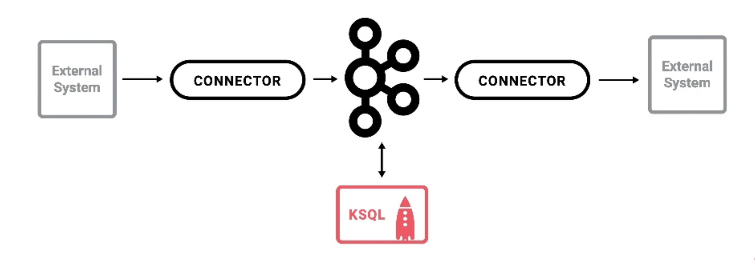
Where it is used?

Slide 7
Why it is used?
Real-time monitoring meets real-time analytics
Security and anomaly detection
Online data integration
Application Development

Slide 8
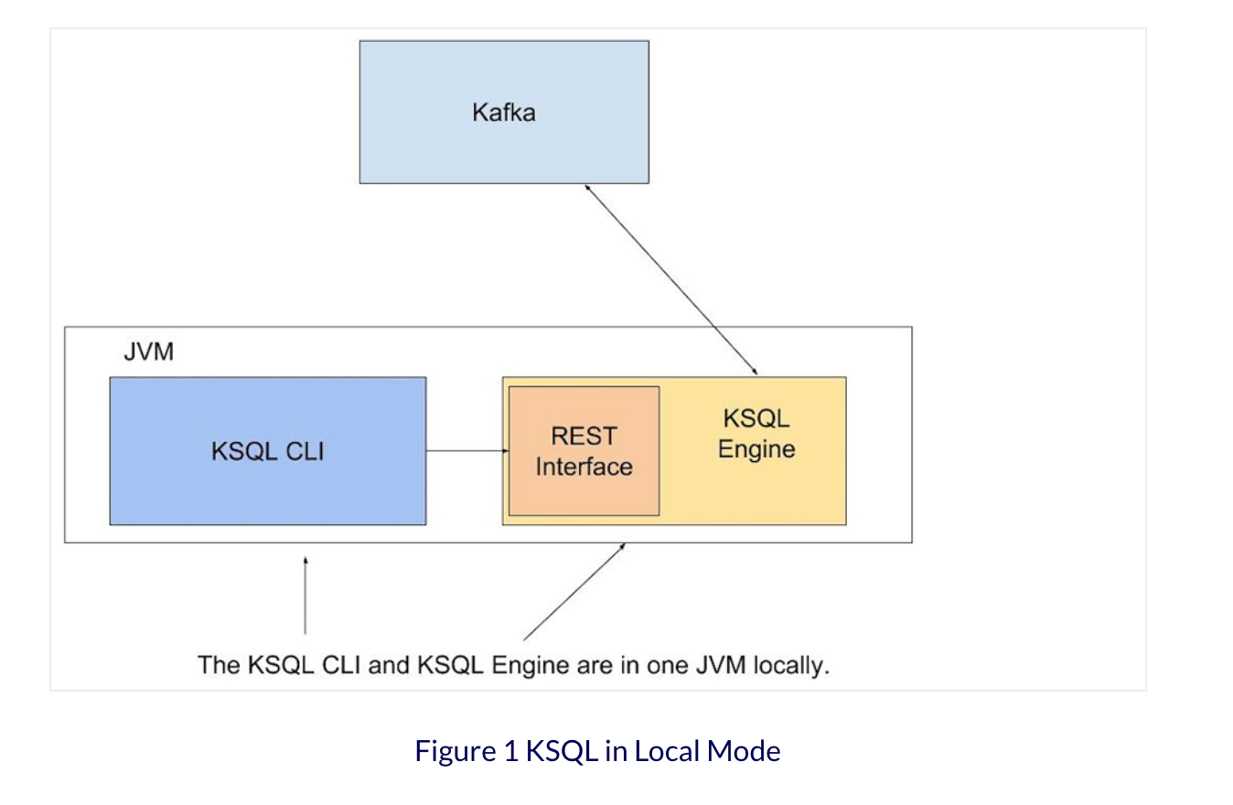
KSQL CLI and KSQL Server

Slide 9
KSQL Statements
CREATE STREAM
CREATE TABLE
CREATE STREAM AS SELECT
CREATE TABLE AS SELECT
DESCRIBE
EXPLAIN
DROP STREAM
DROP TABLE
PRINT
SELECT
SHOW TOPICS
SHOW STREAMS
SHOW TABLES
SHOW QUERIES
SHOW PROPERTIES
TERMINATE

Slide 10
KSQL SUPPORTED DATA TYPES
BOOLEAN
INTEGER
BIGINT
DOUBLE
VARCHAR (or STRING)
ARRAY<ArrayType> (JSON and AVRO only)
MAP<VARCHAR, ValueType> (JSON and AVRO only)
Notes:
https://docs.confluent.io/current/ksql/docs/syntax-reference.html

Slide 11
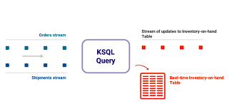
Stream and Table:

Slide 12
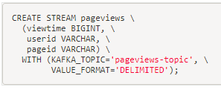
Creating a stream
> Stream with no key
Notes:
CREATE STREAM pageviews(viewtime bigint, userid varchar, pageid varchar) WITH (kafka_topic='pageviews', value_format='DELIMITED');

Slide 13
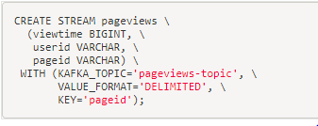
Creating a stream
> Stream with specified key
Notes:
CREATE STREAM pageviews_keyed (viewtime BIGINT, userid VARCHAR, pageid VARCHAR) WITH (KAFKA_TOPIC='pageviews', VALUE_FORMAT='DELIMITED', KEY='pageid');

Slide 14
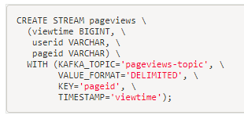
Creating a stream
> Stream with specified key and timestamp
Notes:
CREATE STREAM pageviews_timestamped (viewtime BIGINT, userid VARCHAR, pageid VARCHAR) WITH (KAFKA_TOPIC='pageviews', VALUE_FORMAT='DELIMITED', KEY='pageid', TIMESTAMP='viewtime');

Slide 15
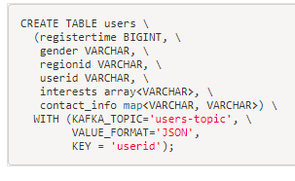
Creating a Table
NOTE: Specifying Key is required in Table creation
Notes:
CREATE TABLE users (registertime BIGINT, gender VARCHAR, regionid VARCHAR, userid VARCHAR) WITH (kafka_topic='users', value_format='JSON', key = 'userid');

Slide 16
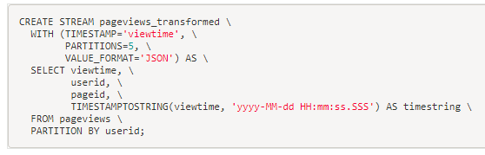
Transforming
Notes:
CREATE STREAM pageviews_transformed WITH (TIMESTAMP='viewtime', PARTITIONS=5, VALUE_FORMAT='JSON') AS SELECT viewtime, userid, pageid, TIMESTAMPTOSTRING(viewtime, 'yyyy-MM-dd HH:mm:ss.SSS') AS timestring FROM pageviews PARTITION BY userid;

Slide 17
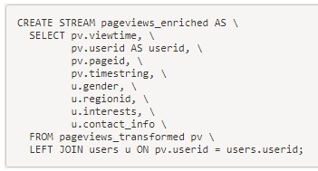
Joining
Notes:
CREATE STREAM pageviews_enriched AS SELECT pv.viewtime, pv.userid AS userid, pv.pageid, pv.timestring, u.gender, u.regionid FROM pageviews_transformed pv LEFT JOIN users u ON pv.userid = u.userid;

Slide 18
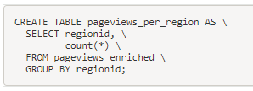
Aggregating
Notes:
CREATE TABLE pageviews_per_region AS SELECT regionid, count(*) FROM pageviews_enriched GROUP BY regionid;

Slide 19
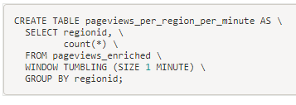
Windowing
Notes:
CREATE TABLE pageviews_per_region_per_minute AS SELECT regionid, count(*) FROM pageviews_enriched WINDOW TUMBLING (SIZE 1 MINUTE) GROUP BY regionid;

Slide 20
Windowing: Hopping and Advance
CREATE TABLE pageviews_per_region_per_30secs10secs AS SELECT regionid, count(*) FROM pageviews_enriched WINDOW HOPPING (SIZE 30 SECONDS, ADVANCE BY 10 SECONDS) WHERE UCASE(gender)='FEMALE' AND LCASE (regionid) LIKE '%_6' GROUP BY regionid;
Notes:
CREATE TABLE pageviews_per_region_per_minute AS SELECT regionid, count(*) FROM pageviews_enriched WINDOW TUMBLING (SIZE 1 MINUTE) GROUP BY regionid;

Slide 21
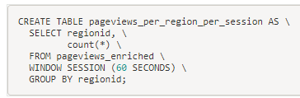
Sessionization
Notes:
CREATE TABLE pageviews_per_region_per_session AS SELECT regionid, count(*) FROM pageviews_enriched WINDOW SESSION (60 SECONDS) GROUP BY regionid;

Slide 22
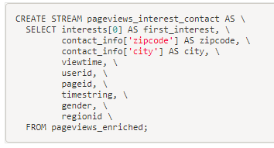
Arrays and maps
Notes:
CREATE STREAM pageviews_interest_contact AS SELECT interests[0] AS first_interest, contact_info['zipcode'] AS zipcode, contact_info['city'] AS city, viewtime, userid, pageid, timestring, gender, regionid FROM pageviews_enriched;

Slide 23
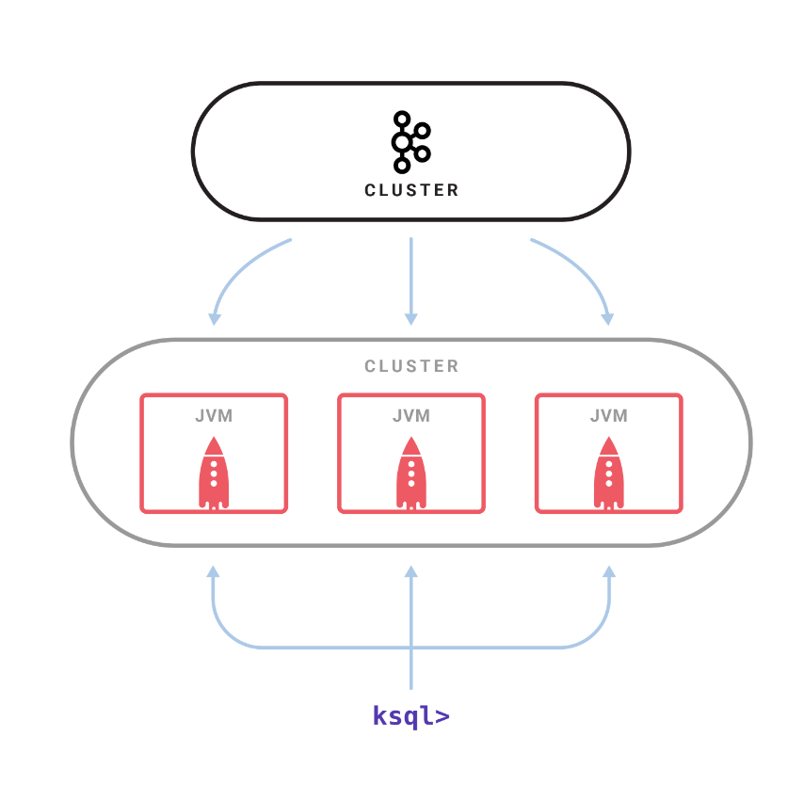
KSQL CLUSTER
Notes:
CREATE STREAM pageviews_interest_contact AS SELECT interests[0] AS first_interest, contact_info['zipcode'] AS zipcode, contact_info['city'] AS city, viewtime, userid, pageid, timestring, gender, regionid FROM pageviews_enriched;

Slide 24
KSQLREST API
https://docs.confluent.io/current/ksql/docs/api.html
Notes:
CREATE STREAM pageviews_interest_contact AS SELECT interests[0] AS first_interest, contact_info['zipcode'] AS zipcode, contact_info['city'] AS city, viewtime, userid, pageid, timestring, gender, regionid FROM pageviews_enriched;

Slide 25
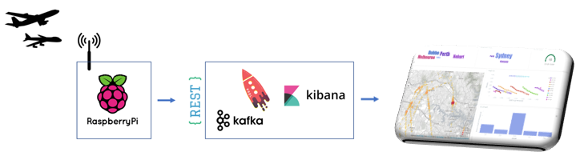
KSQL USE CASE:

Slide 26
References:
https://www.confluent.io/product/ksql/
https://docs.confluent.io/current/ksql/docs/tutorials/index.html

Slide 27

Thanks!

